Slide 1




Capstone Phase B
Nappi – Digital Twin Platform For infant sleep monitoring
Project Code: 25-2-D-22
Oran Efroni & Ofer Elzara
Supervisor – Mr. Uzi Rozen
Notes:
עופר

Slide 2

Agenda Overview
03
Problem & Motivation
04
System Overview
05
Key Decisions & Constraints
06
Four-Tier Architecture
09
Essential Requirements
10
IoT Edge Device
11
Real-Time Alerting System
12
Key Backend Services
13
Awakening Correlation Analysis
14
Context Aware AI Chat
15
Database Design
16
Key Algorithms
17
Evaluation
18
Phase B Timeline
19
Demonstration video
Notes:
עופר

Slide 3


Problem & Motivation
Problem:
After surveying a small group of new parents, we identified key infant sleep problem:
Lack of accessible, user-friendly
sleep-oriented monitoring tools
Existing solutions give an incomplete picture
Uncertainty of what triggers awakenings
Difficulty identifying sleep patterns for daily schedule
No way to track long-term sleep trends or improvement without data-driven insights
Notes:
עופר

Slide 4

System Overview
Solution:
Nappi is a digital twin inspired infant sleep monitoring PoC that helps parents understand sleep by turning sensor data and sleep/wake events into correlation-based insights and likely contributing factors.
What It Does:
• Tracks sleep sessions and room environment in real time
• Sends real-time alerts via SSE and Web Push
• Correlates environmental changes with awakenings
• Provides AI-generated explanations and a context-aware chat assistant
• Computes daily summaries, trends, optimal conditions, and schedule predictions
Notes:
עופר

Slide 5


Key Decisions & Constraints
Hardware downshift: Moved from Raspberry Pi to M5Stack Core2 (modular sensors, no soldering)
Sleep state approach: Eye-tracking wasn’t reliable for a sleeping baby and was too heavy for the device, so we used a ML AI Camera to run a lightweight on-device model that outputs a naive asleep / awake / away classification as a sufficient PoC demonstration for this component.
Privacy first camera: No video/images leave device except classification result
Validation constraint: No real infant sleep dataset, moved to a PoC with mock data & persona-based validation
Notes:
עופר

Slide 6

Four-Tier Architecture
IoT Layer (M5Stack Core2):
• Pulls live data of temperature, humidity, noise level, and AI-camera sleep state (sleep/awake/no-baby).
• Shares data upstream by a lightweight on-device HTTP server
Backend Layer (FastAPI + Python):
• 4 RESTful API routers: monitoring, sensor events, statistics, chat
• APScheduler: sensor polling (5s), daily summaries, optimal stats
• Google Gemini AI for awakening insights and chat
• SSE + Web Push (VAPID) for real-time alert delivery
Notes:
עופר

Slide 7
Four-Tier Architecture
Frontend Layer (React + TypeScript):
• Dashboard, statistics, notifications, AI chat, user profile
• ECharts for data visualization
• Session cookie auth, responsive design with Tailwind CSS
Database Layer (PostgreSQL + SQLAlchemy):
• Neon serverless PostgreSQL - "Nappi" schema, raw SQL via text(), no ORM
• DatabaseManager singleton • SQL migrations for schema versioning
Notes:
עופר

Slide 8
Four-Tier Architecture
Notes:
עופר

Slide 9
Essential Requirements
Data Integrity: Continuously log temperature, humidity, and noise with timestamps, enabling retrospective trend
Performance: Deliver alerts to the dashboard instantly via SSE, with web push fallback when the app is closed
Functionality: Generate awakening insights by analyzing sensor-change magnitude in a configurable window before each wake-up event
Usability: Provide a context-aware AI chat that answers parent questions using the baby's full stored context
Notes:
עופר

Slide 10
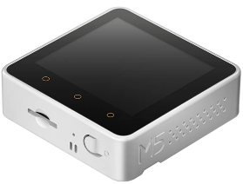
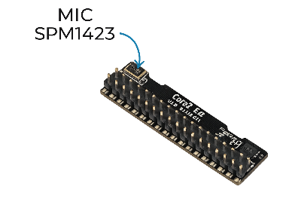
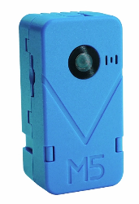
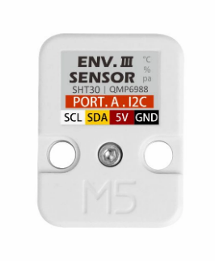
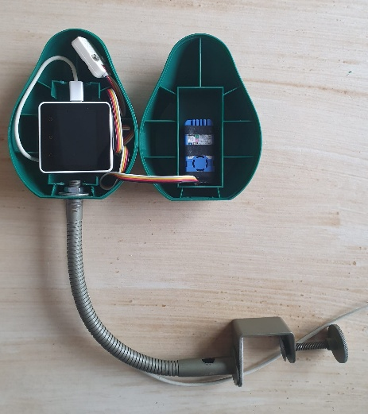
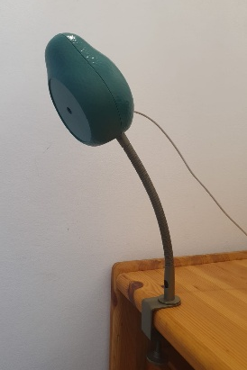
IoT Edge Device
Main microcontroller: M5Stack Core2 + M5GO2
Communication:
• Sensor readings assembled as JSON, served via HTTP endpoint
• Backend scheduler polls at configurable interval (5s default)
• M5Stack sends HTTP POST for sleep-state changes
(sleep-start, sleep-end, baby-away)
Runtime:
• Single MicroPython event loop
• Handles sensors + HTTP server + WiFi on one thread
• Camera verdict debouncing for stable state detection
Notes:
עופר

Slide 11
Real-Time Alerting System
The system creates alerts for key events and delivers them in real time:
• Baby wake-up alerts
• Sensor threshold warnings (temperature, humidity, noise)
• Read/unread state with unread counter per user
• Severity levels in each alert for prioritization
Delivery Channels:
• Server-Sent Events - live updates to connected frontend clients
• Web Push Notifications (VAPID) - when the app is not open
• Alert history stored per user with baby’s id reference
Notes:
עופר

Slide 12
Key Backend Services
Sleep State Manager: Live sleep tracking & intervention pacing.
Alert Service: Real-time notifications for awakenings and sensor thresholds.
Correlation Analyzer: AI-driven insights from post-sleep sensor data.
Trend Analyzer: Weekly/monthly summaries, consistency scoring, age-aware comparisons.
Schedule Predictor: Pattern-based sleep forecasting.
Chat Service: Context-aware AI caregiver assistance.
Notes:
אורן

Slide 13
Awakening Correlation Analysis
Triggered automatically on each sleep-end event:
1. Retrieve sensor readings from the hour preceding awakening
2. Split readings into first 25% and last 25% time windows
3. Calculate percentage change per parameter (temp, humidity, noise)
4. Filter only significant changes
5. Send significant changes to Gemini AI for structured insight generation
6. Store correlation record linked to the awakening event
This allows parents to understand not just when their baby woke up, but what environmental factors may have contributed to the awakening.
Notes:
אורן

Slide 14
Context Aware AI Chat
Context Built From Stored Data:
• Baby profile and caregiver notes
• Optimal stats (best sleep conditions for this baby)
• Recent awakenings with AI-generated insights
• Recent correlations and daily summaries
• Monthly sleep patterns and latest room readings
Design Principles:
• Gentle, supportive tone - never alarming
• All Gemini calls are synchronous, run in executor
• 60-second timeout for complex queries
• Responses based on baby's actual data, not generic advice
Notes:
אורן

Slide 15
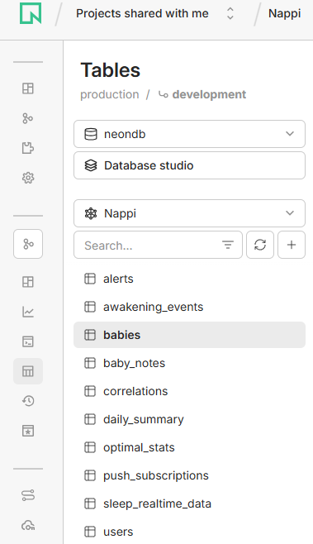
Database Design
PostgreSQL (Neon serverless) - Schema: “Nappi”:
• Tables hold babies/caregivers, sleep sessions, sensor readings, alerts, and derived summaries
• Daily aggregation inserts summary/optimal rows and removes older raw real-time rows
• Automated seeding clears the tables and reloads a consistent mock dataset each run
Notes:
אורן

Slide 16

Key Algorithms
Sleep Pattern Clustering: Groups monthly sleep sessions by time-of-day using a 2-hour gap rule, then summarizes each cluster’s typical start/end/duration.
Sleep Block Grouping: Merges nearby wake events into one “sleep block” so brief wake-ups aren’t counted as separate sessions, and outputs sleep minutes + interruption count.
Trend Analysis: Builds 7/30-day summaries from sleep blocks (daily hours, sessions), adds a consistency score and simple direction (improving / stable / declining), with optional AI notes.
Schedule Prediction: Estimates the next sleep time using age-based wake windows + recent awakenings, with confidence levels and fallbacks to learned patterns or time-of-day rules.
Notes:
אורן

Slide 17
Evaluation
Aspect | Methodology | Requirement | Status
Real-time Monitoring | Run M5Stack demo mode (simulated sleep cycle) and verify logger and database output | Sensor's data polled every 5s with live SSE streaming | ✓
AI Context Accuracy | 10 fixed caregiver prompts, manual check | ≥ 80% answers are relevant and baby-specific | ✓
Statistics Screen Render Time | Measure statistics page graphs UI refresh time after changing sensor or date range | ≤ 2 seconds per chart | ✓
Alert Delivery Latency | Trigger alerts, measure times from backend logged alert to server sent event | ≤ 2 seconds | ✓
Notes:
אורן

Slide 18

Phase B Timeline
Oct 2025
Nov 2025
Dec 2025
Jan-Feb 2026
Foundations
Hardware & Core Services
Analytics & AI Integration
Polish & Deployment
First commit: backend & frontend repos
FastAPI structure, basic endpoints
React skeleton, login page
PostgreSQL schema design (Neon)
Moved from Raspberry Pi to M5Stack
Authentication & user management
DB connection, babies CRUD
Awakening event handling
Sensor data pipeline (temp, humidity, noise)
Ui implementation from phase A figma design + integration with react skeleton and existing backend logic
Statistics page & ECharts Profile page, dashboard UI
Gemini AI: correlation insights & chat
Trend analysis, schedule predictor
Sleep blocks, optimal stats
End-to-end integration
Verification of integration and database data insertion (both backend & controller on same wifi)
Vercel deployment (frontend)
Render deployment (backend)
TypeScript strict mode fixes
SSE + Web Push finalization
demo video
Phase B book
Final code and submission corrections
Notes:
אורן

Slide 19
Demonstration
video Link
Notes:
אורן

Slide 20
THANK YOU for listening!
Notes:
אורן

